Slide 1


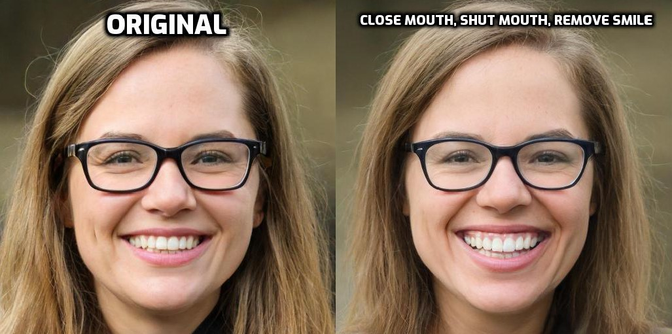
FaceGAN: Text-based image manipulation of human face without incorporating gender bias
PRESENTATION BY: SUPERVISOR:
1. Suhaibur Rehman 1. Prof. James Davenport
2. Joe Goodier
1

Slide 2
CHAPTER 1: INTRODUCTION
MOTIVATION
Investigate the text-based image manipulation of human faces using StyleGAN [1] and CLIP [2].
Integrate StyleGAN with CLIP using global direction approach [3].
Mitigate the gender bias from from StyleCLIP using DCNN, “StyleCLIP”.
4. Propose a new method called “FaceGAN” capable of manipulating human face images using text prompts
from user without incorporating any gender bias.
1

Slide 3
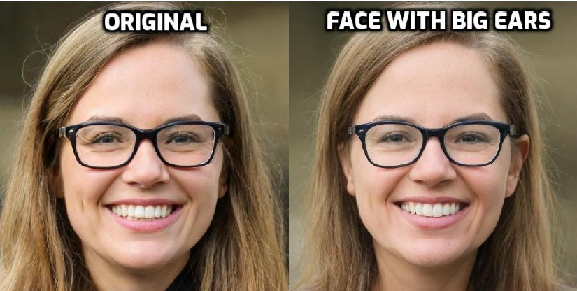
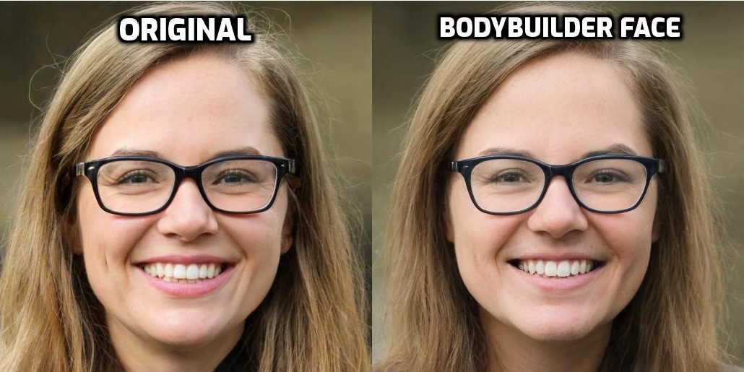
StyleCLIP Challenges [4]
1. Non-target feature manipulation
2. Gender Bias
1

Slide 4
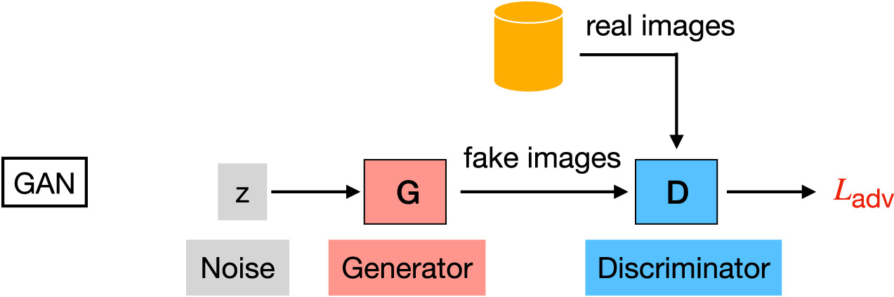
Chapter 2: Literature Survey
Auto-Encoder
Generative Models
Generative Adversarial Networks
Text-based image manipulation
StyleGAN and its progression
CLIP and work related to it
Mitigation of gender bias in machine learning
1

Slide 5
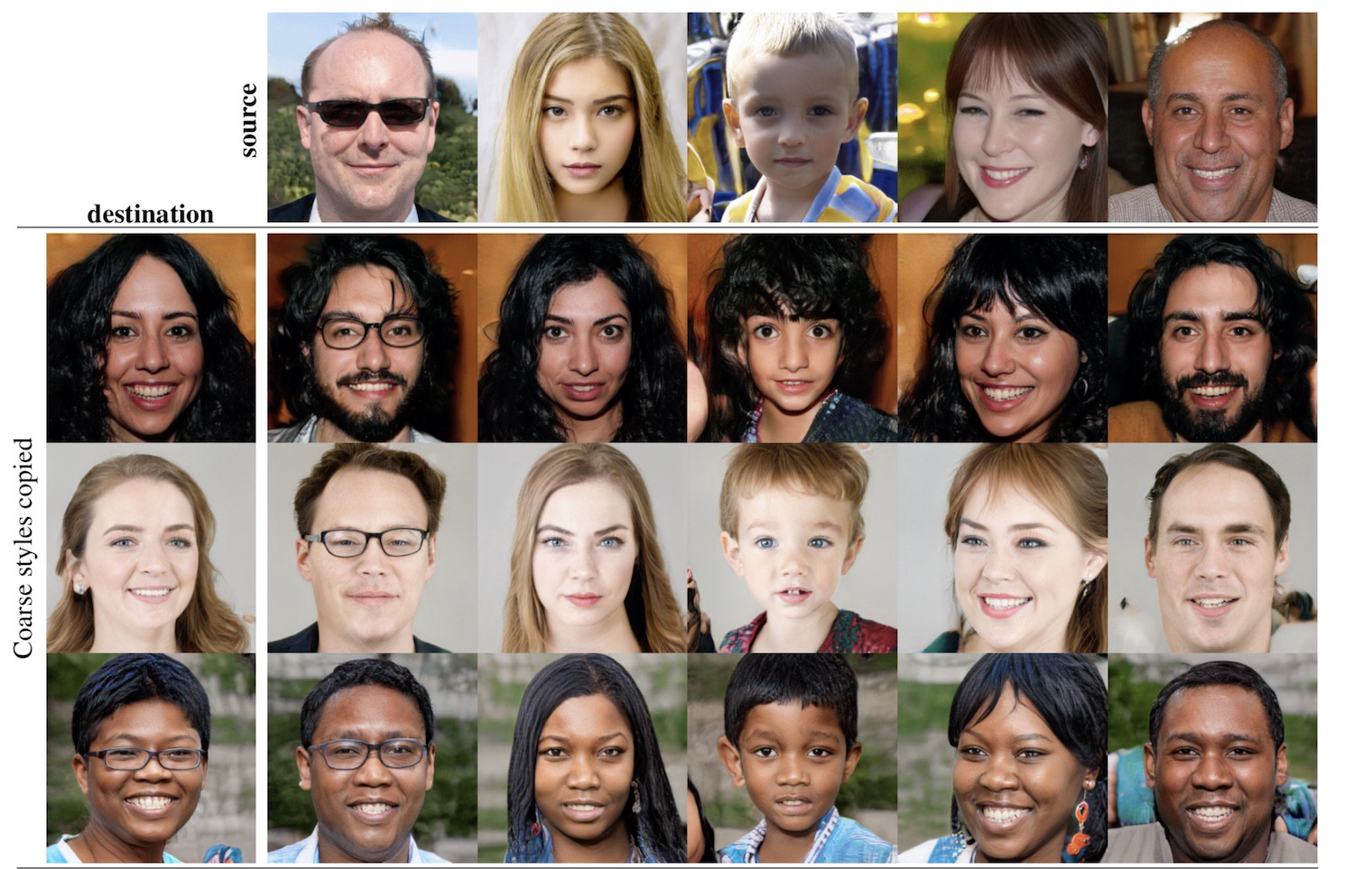
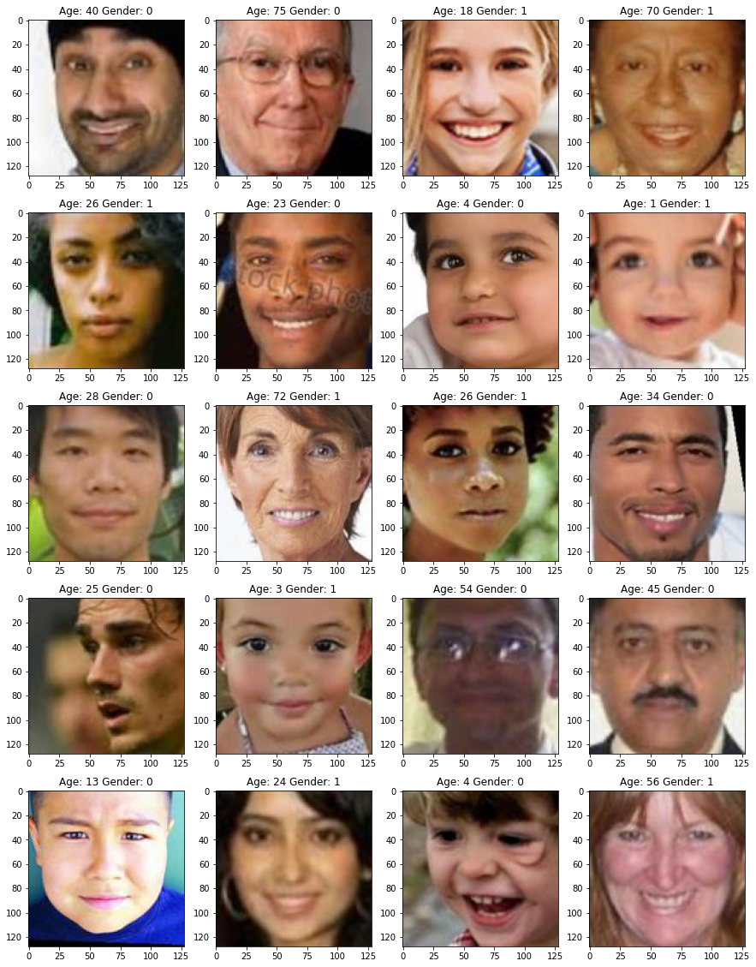
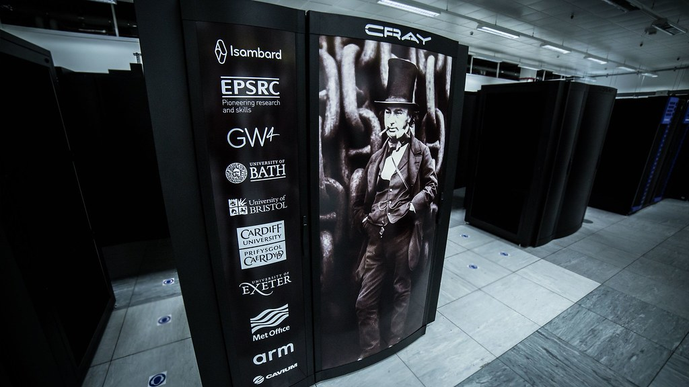

Chapter 3: Requirements
Annotated Datasets
DL Frameworks
GPU
1

Slide 6
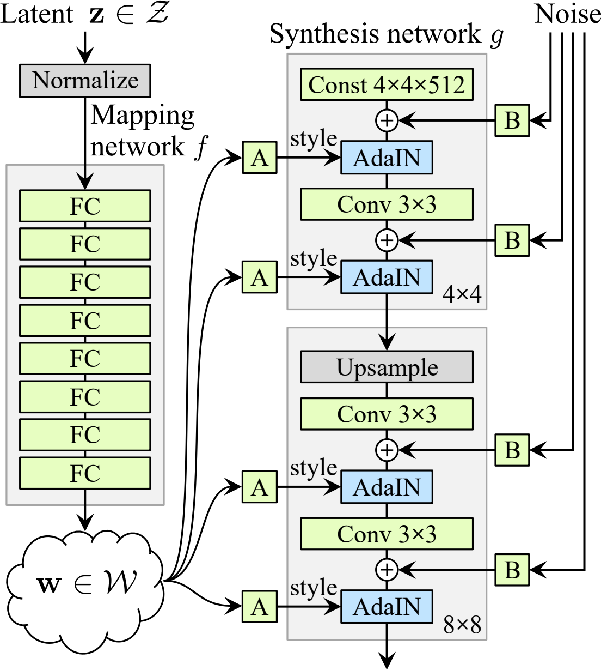
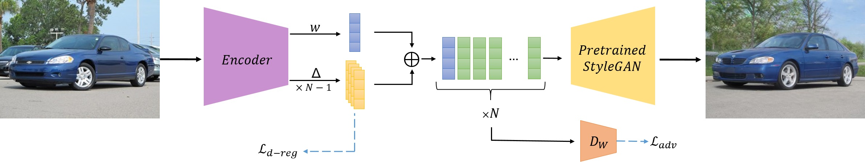
Chapter 4: Methadology
StyleGAN
Implementation based on rosinality impmentation in PyTorch [4].
Fine tuning by freezing the discriminator [5].
Mixing Regularization [6].
Inversion of Image using e4e encoder [7].
1

Slide 7
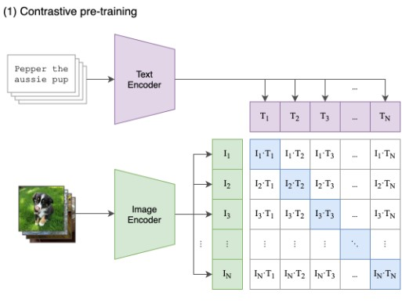
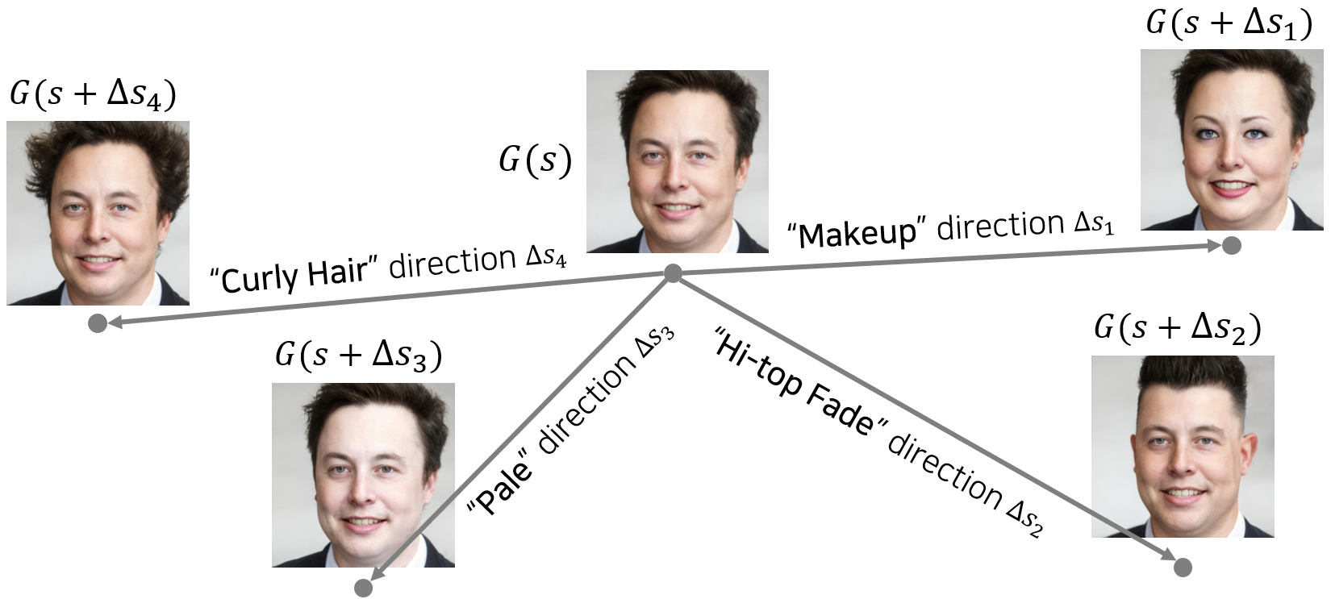
Chapter 4: Methadology
CLIP
Resnet-50 as Image Encoder [8]
DistillBert as Text Encoder [9]
Integerating with StyleGAN using global direction [10].
1

Slide 8
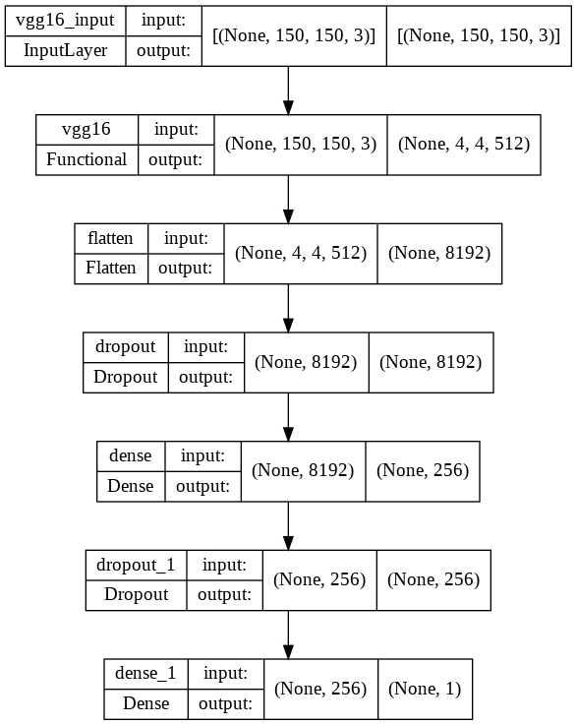

Chapter 4: Methadology
VGG-16
1. Imported pre-trained VGG-16, weight = imagenet.
2. Image augmentation, trained on UTKFace Dataset.
3. Combined it with discriminator of StyleGAN.
4. Optimizer = sgd, Loss function = binary cross_entropy, Meteric = accuracy
1

Slide 9


StyleGAN
Final Image
Latent Mapper
GENERATOR
Image Input
Inversion Encoder
Generated Image
Real or Fake
Image Encoder
CLIP
Image-Text Mapping
True: Real, False: Fake
Text Encoder
Generated Image
Input Caption
DISCRIMINATOR
IF (A == B)
Gender Output B
VGG-16
Gender Output: A
FaceGAN: Proposed Method

Slide 10
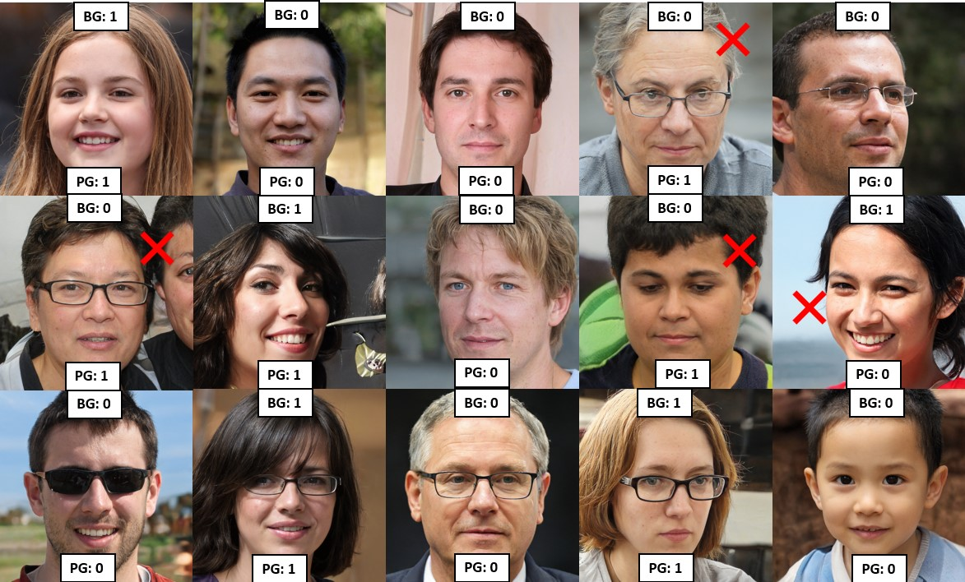
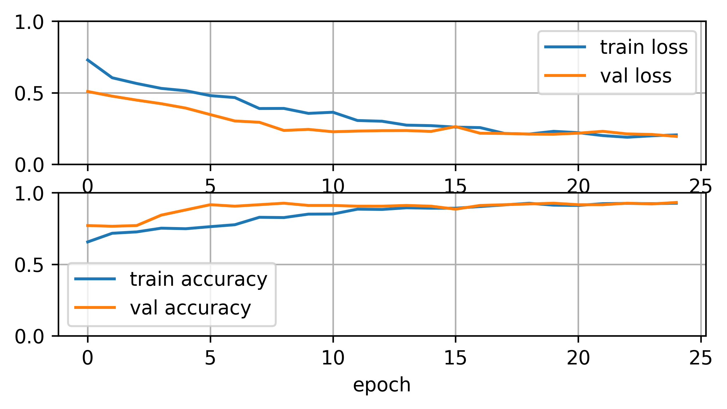
Chapter 6: Result
VGG-16 performance in detecting the gender
Test Accuracy > 90%
1

Slide 11
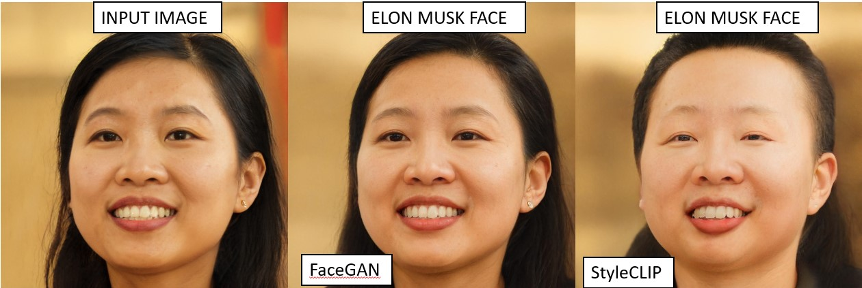
Comparison of FaceGAN: proposed method and
StyleCLIP in gender bias free text-image synthesis
1. FaceGAN failed when the parameter manipulation strength
and disentanglement had low or high values
2. Made a Blunder!,
“Undesired manipulation where changes of opposite gender was desired”
1

Slide 12
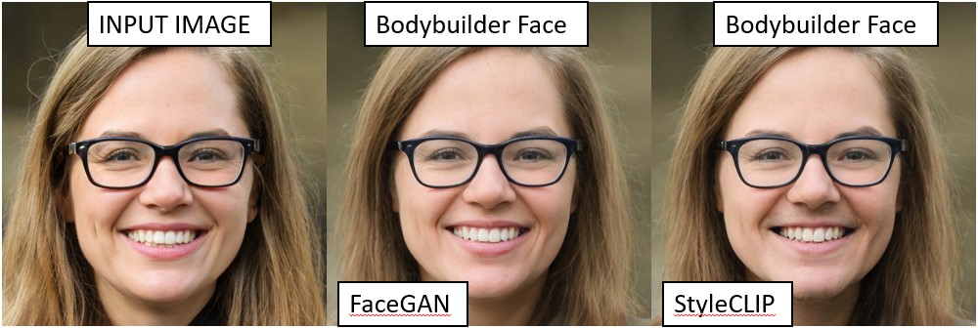
Comparison of FaceGAN: proposed method and
StyleCLIP in gender bias free text-image synthesis
3. Achievement!
“Positive gender characteristics preserved when
gender bias prompt given”
1

Slide 13
REFERENCES
Alaluf, Y., Patashnik, O., Wu, Z., Zamir, A., Shechtman, E., Lischinski, D. and Cohen-Or, D.,
2022. Third time’s the charm? image and video editing with stylegan3 [Online]. Available
from: https://doi.org/10.48550/ARXIV.2201.13433.
Awasthi, P., Kleindessner, M. and Morgenstern, J., 2019. Equalized odds postprocessing
under imperfect group information [Online]. Available from: https://doi.org/10.48550/
ARXIV.1906.03284.
Ba, J., Swersky, K., Fidler, S. and Salakhutdinov, R., 2015. Predicting deep zero-shot
convolutional neural networks using textual descriptions [Online]. Available from: https:
//doi.org/10.48550/ARXIV.1506.00511.
Bahng, H., Yoo, S., Cho, W., Park, D.K., Wu, Z., Ma, X. and Choo, J., 2018. Coloring with
words: Guiding image colorization through text-based palette generation. Eccv.
Beal, M.J., 1970. Variational algorithms for approximate bayesian inference. Available from:
https://discovery.ucl.ac.uk/id/eprint/10101435/.
Bengio, Y., Courville, A. and Vincent, P., 2013. Representation learning: A review and
new perspectives. Ieee transactions on pattern analysis and machine intelligence, 35(8),
pp.1798–1828.
1

